Slide 1
this keyword in java
There can be a lot of usage of java this keyword. In java, this is a reference variable that refers to the current object.

Slide 2
Usage of java this keyword
1.this can be used to refer current class instance variable.
2.this can be used to invoke current class method (implicitly)
3.this() can be used to invoke current class constructor.
4.this can be passed as an argument in the method call.
5.this can be passed as argument in the constructor call.
6.this can be used to return the current class instance from the method.

Slide 3
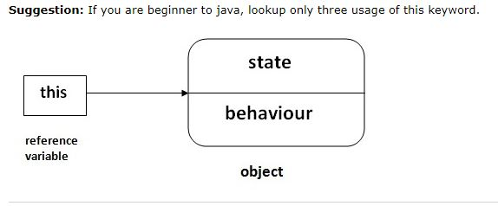

Slide 4
Real usage of this() constructor call
The this() constructor call should be used to reuse the constructor from the constructor.
It maintains the chain between the constructors i.e. it is used for constructor chaining.
Let's see the example given below that displays the actual use of this keyword.

